Slide 1
CIS 4526 Foundations of Machine Learning
Chapter 2
Python as a ML Platform
and other pre-requisites

Slide 2
Outline
Python as a ML Platform
Jupyter notebook
Python Crash Course
Pandas
Other Prerequisite
SQL
Linear Algebra
Probability and Statistics (next Chapter)

Slide 3
Outline
Python as a ML Platform
Jupyter notebook
Python Crash Course
Pandas
Other Prerequisite
SQL
Linear Algebra
Probability and Statistics (next Chapter)

Slide 4
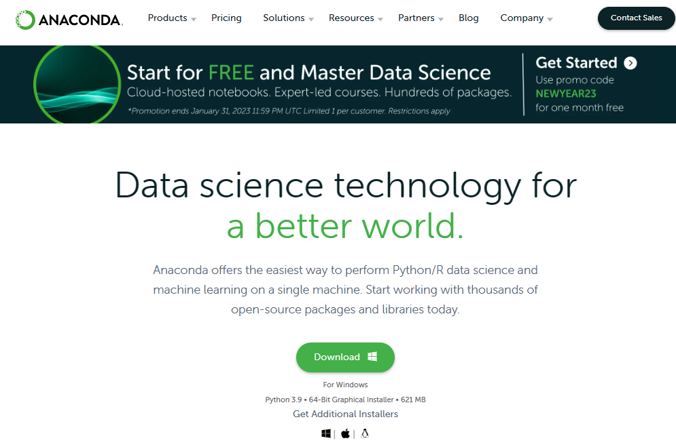
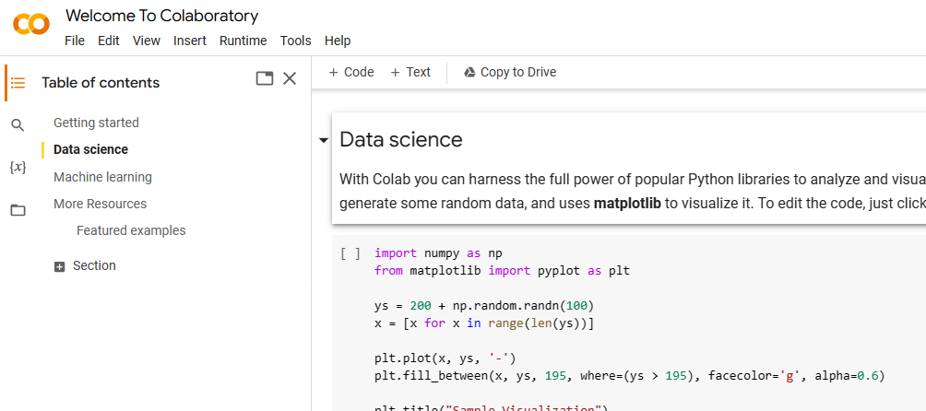
First task: setup a Juypter Notebook environment
There are many ways to run Python code in a Jupyter notebook environment
Run your local version with say Anaconda distribution (anaconda)
Run on the cloud in Google Colab (google colab) or Microsoft Azure ML studio
I recommend running your local version. You will need to submit a file (.ipynb) for grading

Slide 5



Who is your best teacher?
What is the best way to learn new materials these days?
If you give a man a fish, you feed him for a day. If you teach a man to fish, you feed him for a lifetime
One of the best ways to learn is Learn By Example

Slide 6
Outline
Python as a ML Platform
Jupyter notebook
Python Crash Course
Pandas
Other Prerequisite
SQL
Linear Algebra
Probability and Statistics (next Chapter)

Slide 7
Learning By Doing
Go to Python Crash Course notebook

Slide 8
Another way to learn or recap things fast
Anyone?
CheatSheets
One of the best available
https://www.datacamp.com/community/data-science-cheatsheets

Slide 9
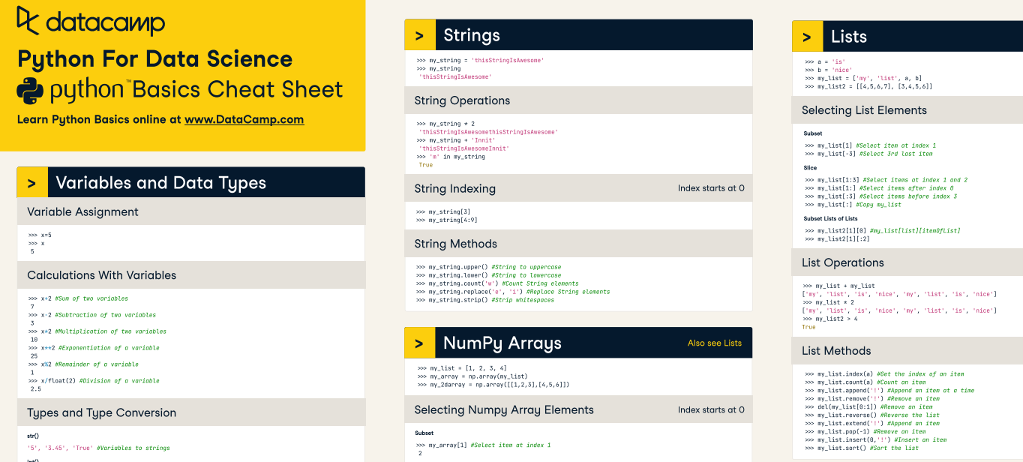
Python CheatSheets

Slide 10
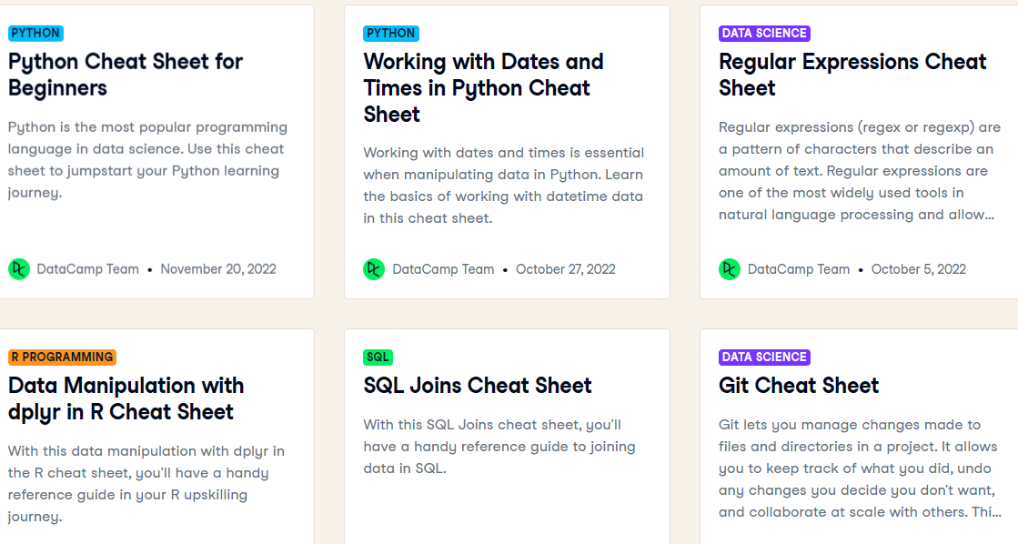
CheatSheets everywhere!

Slide 11
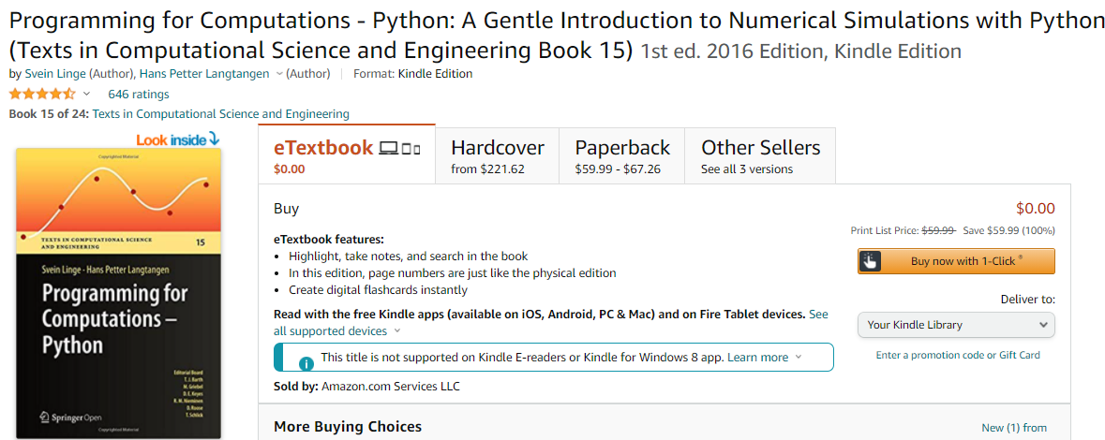
Many online resources available
Free Python course on https://www.datacamp.com/
Nice introduction to python with statistics https://www.kevinsheppard.com/files/teaching/python/notes/python_introduction_2021.pdf
Free book specifically for numerical computation
on Amazon Numerical Simulation in Python
Goal is Learn Python as fast as possible

Slide 12
Self Checklist on Python as a general programming language
Familiar with the various built-in data type, include enumerated types know how to parse a date string into a date object
Know what is a list, and how to loop through each element in the list; know list comprehension
How to do objected-oriented programming in Python
Distinguish between class methods versus instance method, various built-in methods
Decorators, Generators, Introspection
etc.

Slide 13
Outline
Python as a ML Platform
Jupyter notebook
Python Crash Course
Pandas
Other Prerequisite
SQL
Linear Algebra
Probability and Statistics (next Chapter)

Slide 14
Learning By Doing
Go to Pandas notebook

Slide 15
Outline
Python as a ML Platform
Jupyter notebook
Python Crash Course
Pandas
Other Prerequisite
SQL
Linear Algebra
Probability and Statistics (next Chapter)

Slide 16
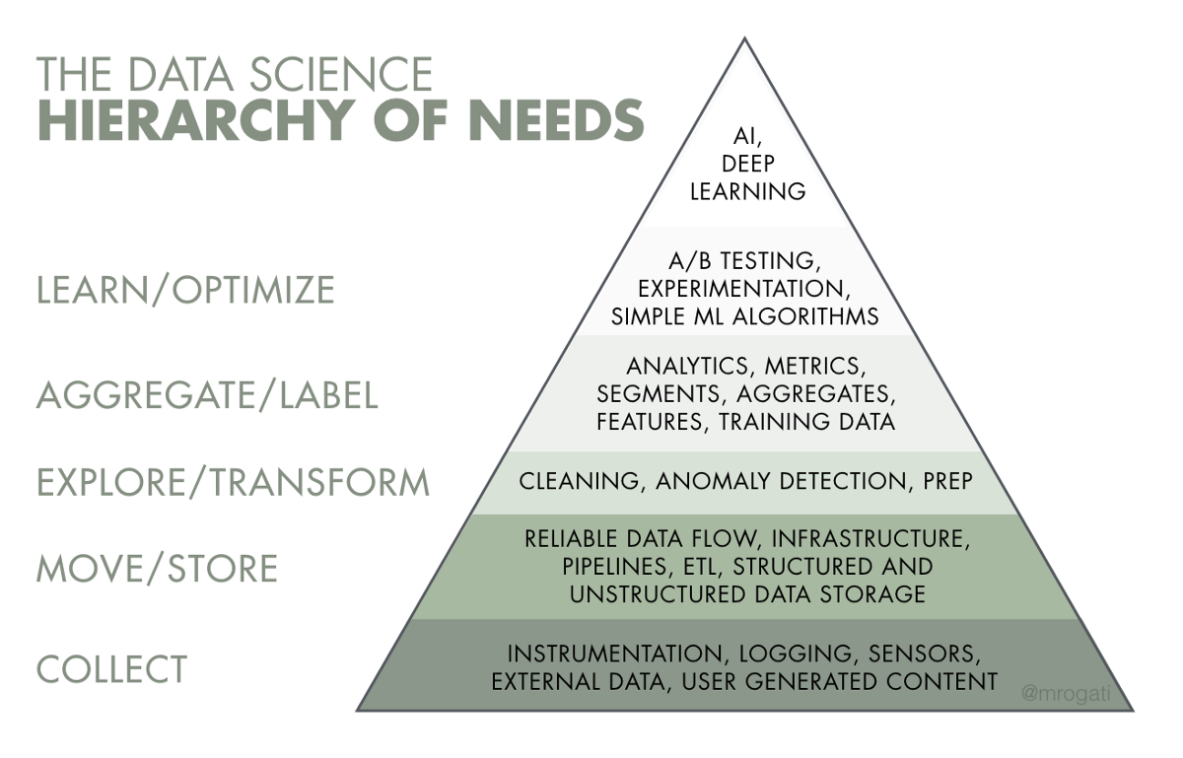
Data Mining 101
(233) Data Scientist vs Data Analyst vs Data Engineer: What's the difference? - YouTube
(233) What REALLY is Data Science? Told by a Data Scientist - YouTube

Slide 17

Data Mining 101
Once we have the data in a datastore, how are we going to get useful information out?
SQL Query => Simple Aggregation (mean) => Simple Statistics (standard deviation) => Hypothesis Testing => Data Mining => Artificial Intelligence
Make sure you master SQL well
Low hanging fruits;
Best bang for the bucks!

Slide 18
SQL
Learning by doing
https://www.w3resource.com/sql-exercises/

Slide 19
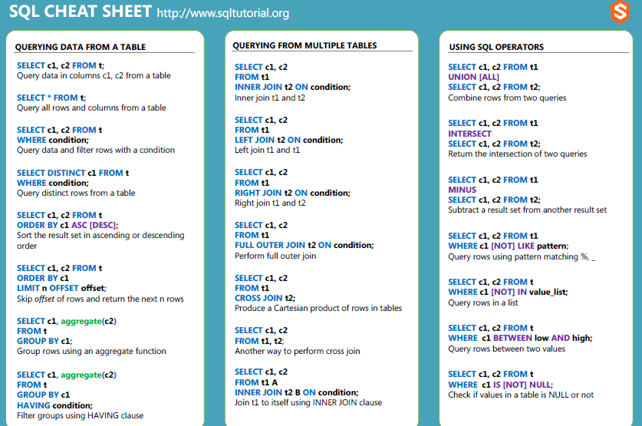
SQL CheatSheet

Slide 20
SQL Check-list
What are primary keys
How to select subset data
How to join two tables
How to group by data
Note: We will NOT spend too much time on SQL, because many of the functions can be done in Python and you should learn it in a formal database class. However, you should make sure you know SQL well !
And I may have some basic questions on SQL in the exam

Slide 21
Outline
Python as a ML Platform
Jupyter notebook
Python Crash Course
Pandas
Other Prerequisite
SQL
Linear Algebra
Probability and Statistics (next Chapter)

Slide 22
Linear Algebra
Matrices
Addition and Multiplication
Element-wise operations
Dot product
Eigenvalues and Eigenvectors
One good place to recall/learn:
Linear Algebra | Khan Academy

Slide 23
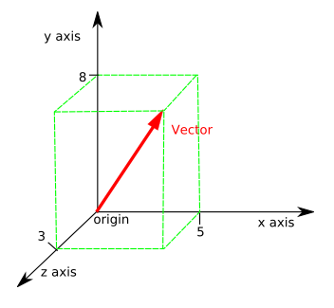
Mathematical Foundation - Linear Algebra
Vector – An array of numbers which can be used to represent the coordinates of a point in a n-dimensional space.
Example v = (5, 8, 3) in 3-dimensional space with x=5, y=8, z=3
A vector has a magnitude as well as a direction.
Example is velocity
One can visualize 2-dim or 3-dim vector graphically, but not anything larger
than 4.
Scalar – A single number which include only magnitude and no direction.
It can be defined as one-dimensional vector.
Examples: weight, height, temperature

Slide 24
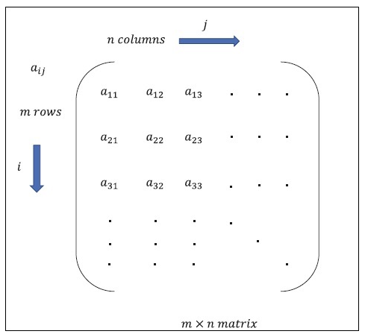
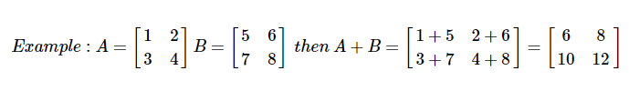
Mathematical Foundation - Linear Algebra
Matrix - Matrix can be defined as multi-dimensional arrays, which are arranged in the format of rows and columns. The size of matrix is defined by row length and column length. Following figure shows the representation of any specified matrix.
Addition

Slide 25
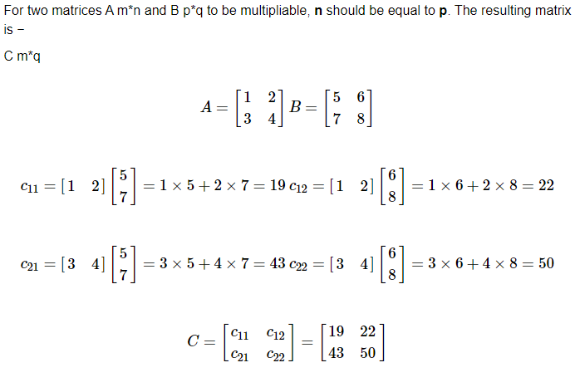
Matrix Multiplication

Slide 26
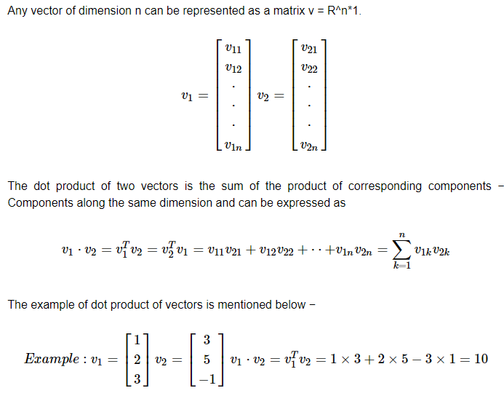
Dot product of vectors

